Slide 1
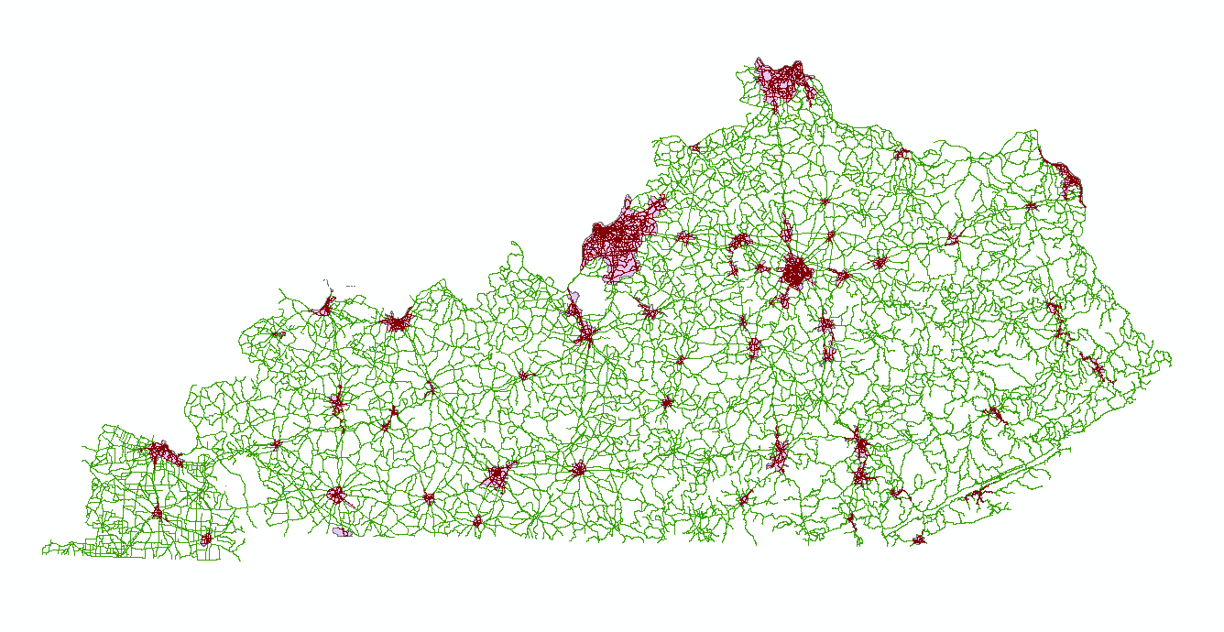
Input data Files:
FHWA_Urbanized_Areas_2010
LN
Coding Steps:
Import required libraries
Reading files and get to understand the data (attributes and features)
Perform an intersection between the two files to get the lanes that are within the urbanized areas
Group the intersected data by the urbanized areas.
Using the “number of lane” attribute and the “Miles” attribute we will calculate the number of lane miles of roadway in each urbanized area in the state of Kentucky.
Using ArcMap this represents the intersection of roads and urbanized areas in the state of Kentucky
Abdulaziz Alhomaidhi
Ashtarout Ammar
Bassam Ramadan

